Slide 1
Information security standards
By-
Ritika GuptA

Slide 2
INTRODUCTION OF INFORMATION SECURITY AND STANDARDS
Information security standards (also known as cyber security standards) are techniques generally outlined in published materials that attempt to protect a user's or organization's cyber environment.
The principal objective is to reduce the risks, including preventing or mitigating cyber-attacks.

Slide 3
Definition
An information security standard is a series of documented processes that define how to implement, manage, and monitor various security controls. As well as providing a blueprint for mitigating risk and reducing vulnerabilities, cybersecurity standards and cybersecurity frameworks typically detail the necessary steps for achieving regulatory compliance.

Slide 4
For Example:
Healthcare organizations in the US must meet strict data protection rules set by HIPAA.
Financial institutions must adhere to PCI DSS, SWIFT CSP, SOX, etc.
Manufacturing companies must meet ISO 27001 and some other compliance standards to protect their customers’ data.
Government agencies must comply with FISMA, NIST 800-53, NIST 800-171, etc.

Slide 5
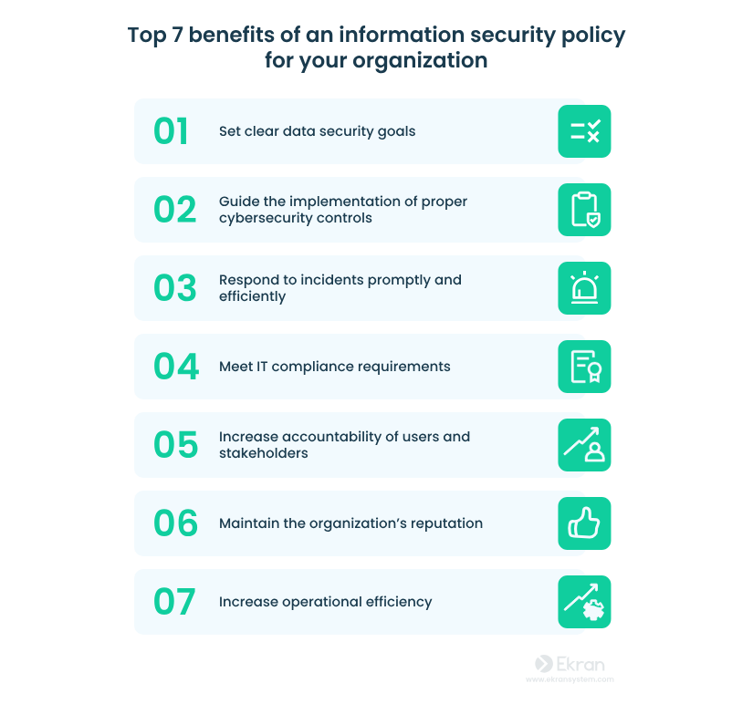
example
Payment Card Industry Data Security Standard (PCI-DSS): PCI-DSS is an industry-standard that applies to organizations that handle credit card information. It mandates a set of security measures to protect cardholder data, including encryption, secure network architecture, and regular monitoring and testing of networks. Compliance with PCI-DSS is essential for businesses that process credit card transactions, as failure to secure payment data can result in fines, increased transaction fees, and loss of the ability to process credit card payments.

Slide 6
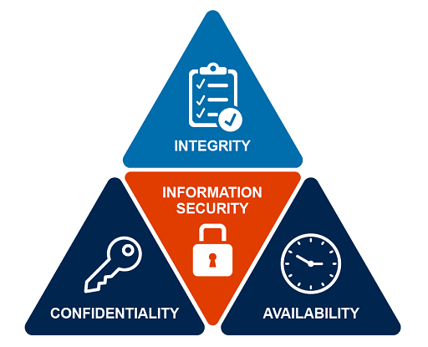
The three Principles of ISO

Slide 7
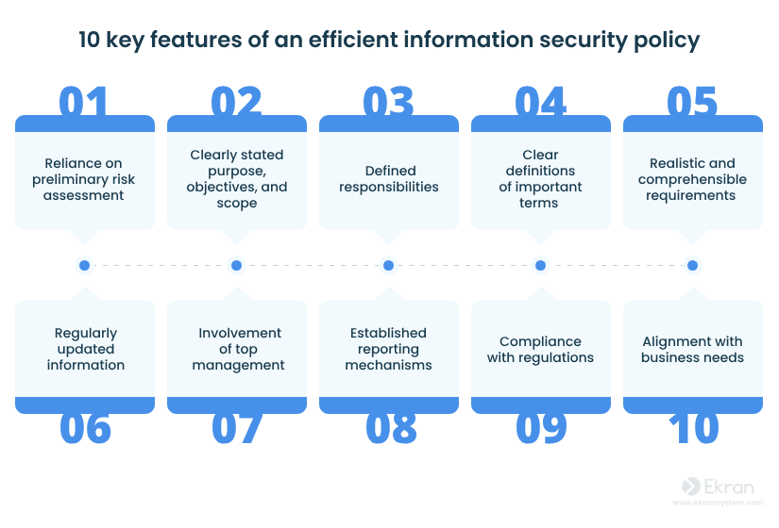

Slide 8
types of information security
Application Security: Identifying and addressing exploitable vulnerabilities in web and mobile applications so malicious actors can’t use them to breach a company’s network.
Network Security: Implementing the policies and controls to protect the data and infrastructure within a company’s network and prevent unauthorized access.
Cloud Security: Strategies and solutions to secure a company’s off-site cloud deployment.
Cryptography: Various processes and techniques to better secure data through encryption. Cryptography prevents sensitive information from being decoded by cybercriminals in the event of a data breach.

Slide 9
Importance in cyber security
Compliance.
Data protection.
Increased awareness of risk.
Building customer trust.
Protecting employee information.
Prevent cyber attack.
Enhanced reputation.

Slide 10

Intellectual Property Law

Slide 11
Definition
Intellectual property rights are the rights given to each and every person for the creation of new things according to their minds. IPR usually give the creator a complete right over the use of his/her creation for a certain period of time.
Properties
1.Industrial designs
Scientific discoveries
Protection against unfair competition
Literary, artistic, and scientific works
Inventions in all fields of human endeavor
Trademarks, service marks, commercial names, and designations

Slide 12
Types of IPR
copyright
Patent IPR Trade secretes
Trade marks

Slide 13
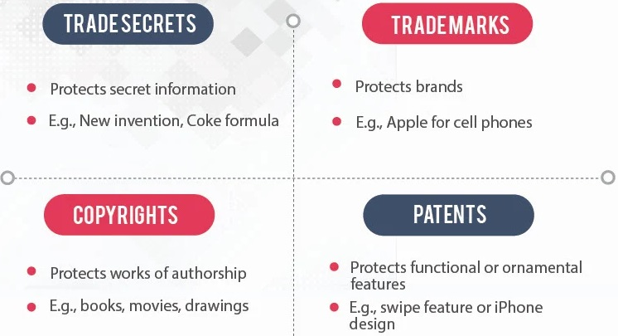

Slide 14
Copy Right Law
Copyright is a form of intellectual property rights. It protects original works such as works of literature, drama, music, artistic works, cinematographic films, audio recordings, etc. It protects the expression of an idea of an author rather than the idea itself.
These are also called the economic rights of the author.
It includes:
Right to reproduce
Right to issue copies
Right to perform at public .Right to make a film or a sound recording

Slide 15
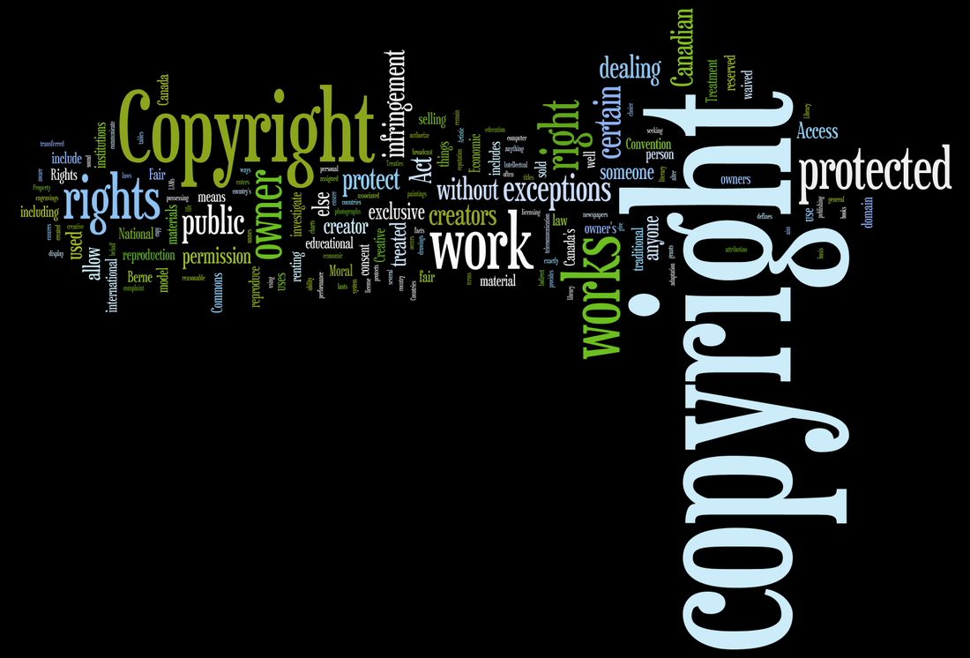

Slide 16
Patent Law:
Patent law- Provides legal protection to the inventions and innovations that companies and individuals develop. In the context of semiconductors and cybersecurity, it’s important for protecting:
Chip Designs and Technologies: Semiconductor companies patent their chip designs, which could include innovations that make devices more secure or help prevent certain types of cyberattacks.
Security Solutions: New technologies (hardware-based encryption, secure boot processes, etc.) developed for semiconductor systems are often patented to prevent others from copying the innovation.
Counteracting Cybersecurity Threats: Patent law helps ensure that security features (like those for preventing physical or software-based attacks) are protected, ensuring that attackers can't easily bypass security measures built into semiconductor devices.

Slide 17
Semiconductor Law:
Semiconductor law- Primarily deals with the legal frameworks that govern the production, sale, and export of semiconductor components. Key aspects related to cybersecurity include:
Supply Chain Security: Ensuring that semiconductor manufacturing processes are secure from tampering, malicious attacks, or espionage.
Export Control Laws: Regulations that control the export of advanced semiconductor technologies that could pose national security risks if they fell into the wrong hands.
National Security: Governments often restrict access to advanced semiconductor technologies (such as those used in military systems or encrypted communications) to prevent security breaches.

Slide 18
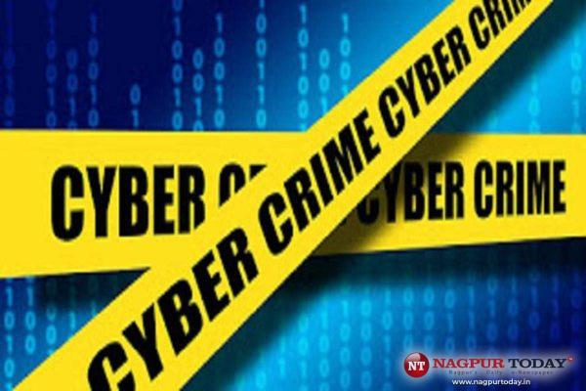
IT ACT 2000
The Information Technology Act, 2000 (also known as
ITA-2000, or the IT Act) is an Act of the Indian Parliament notified on 17 October 2000.
It is the primary law in India dealing with cybercrime and electronic commerce.
The main objective of this act is to carry out lawful and trustworthy electronic, digital, and online transactions and alleviate or reduce cybercrimes.
This legal framework, also known as IT Act 2000, comes with 94 sections, divided into 13 chapters and 2 schedules.
This Photo by Unknown Author is licensed under CC BY-SA-NC

Slide 19
Features of the Information Technology Act of 2000
The digital signature has been changed to an electronic signature to make it a greater generation-impartial act.It elaborates on offenses, penalties, and breaches.
It adds a provision to Section 81, which states that the provisions of the Act shall have overriding effect.

Slide 20
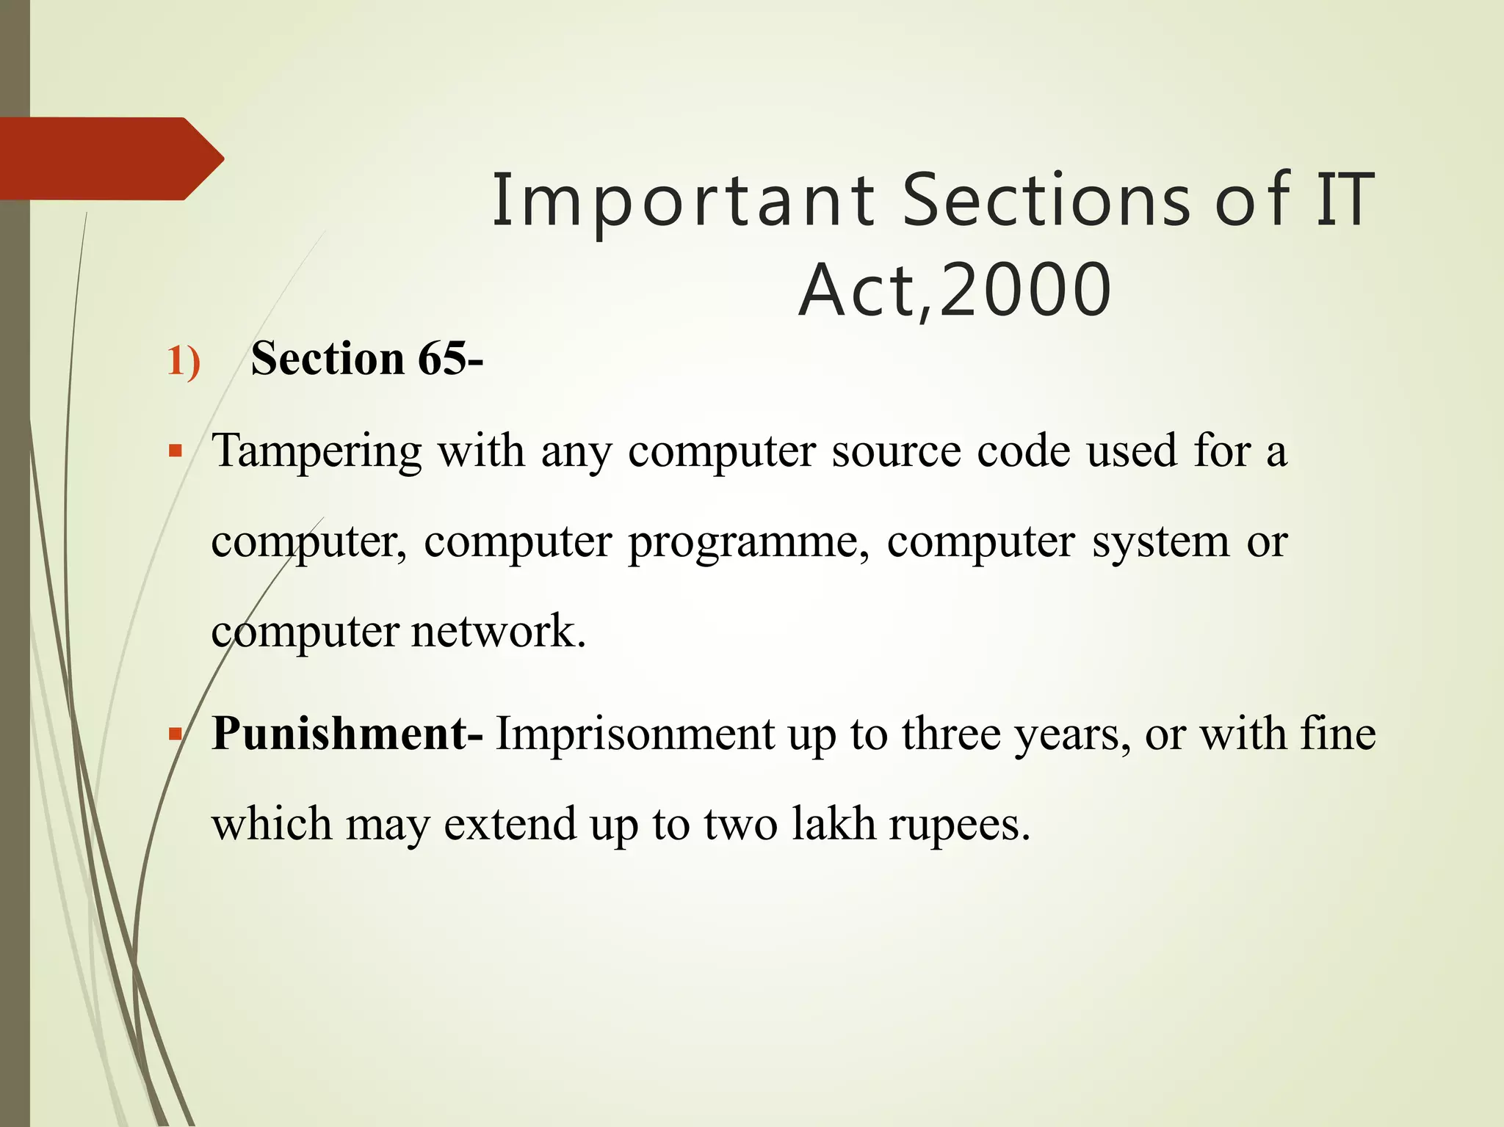
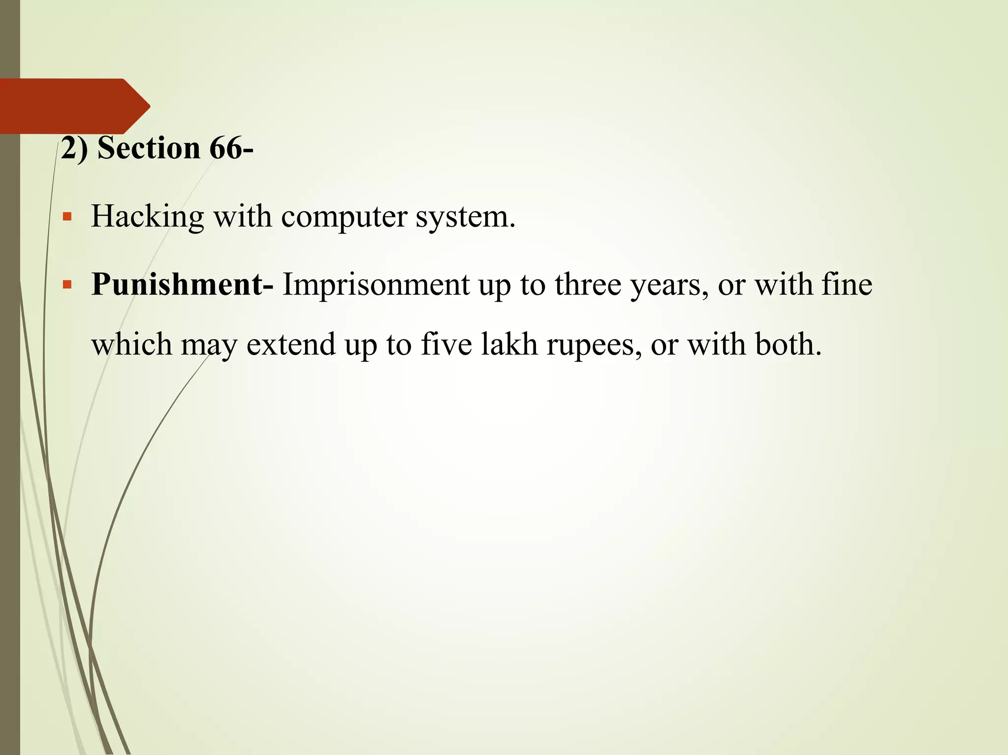

Slide 21
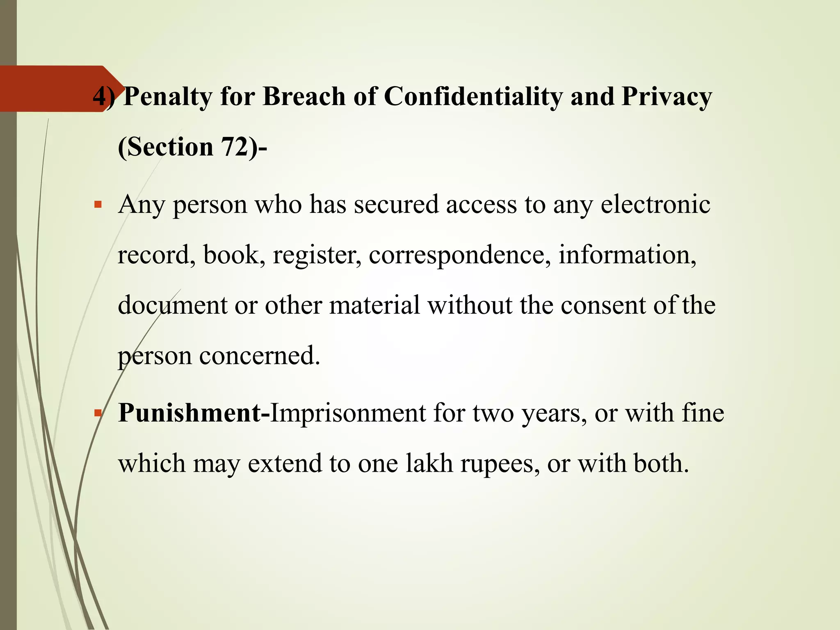
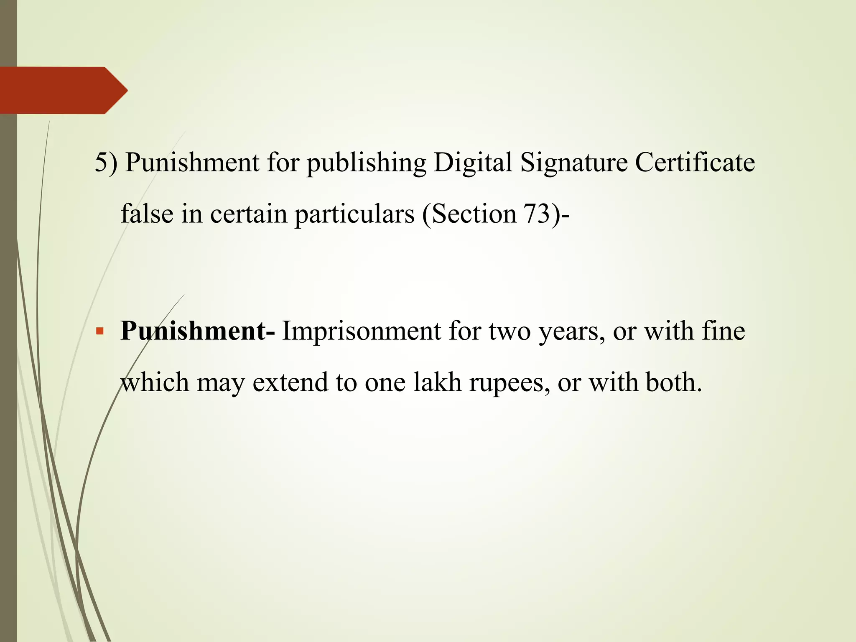

Slide 22
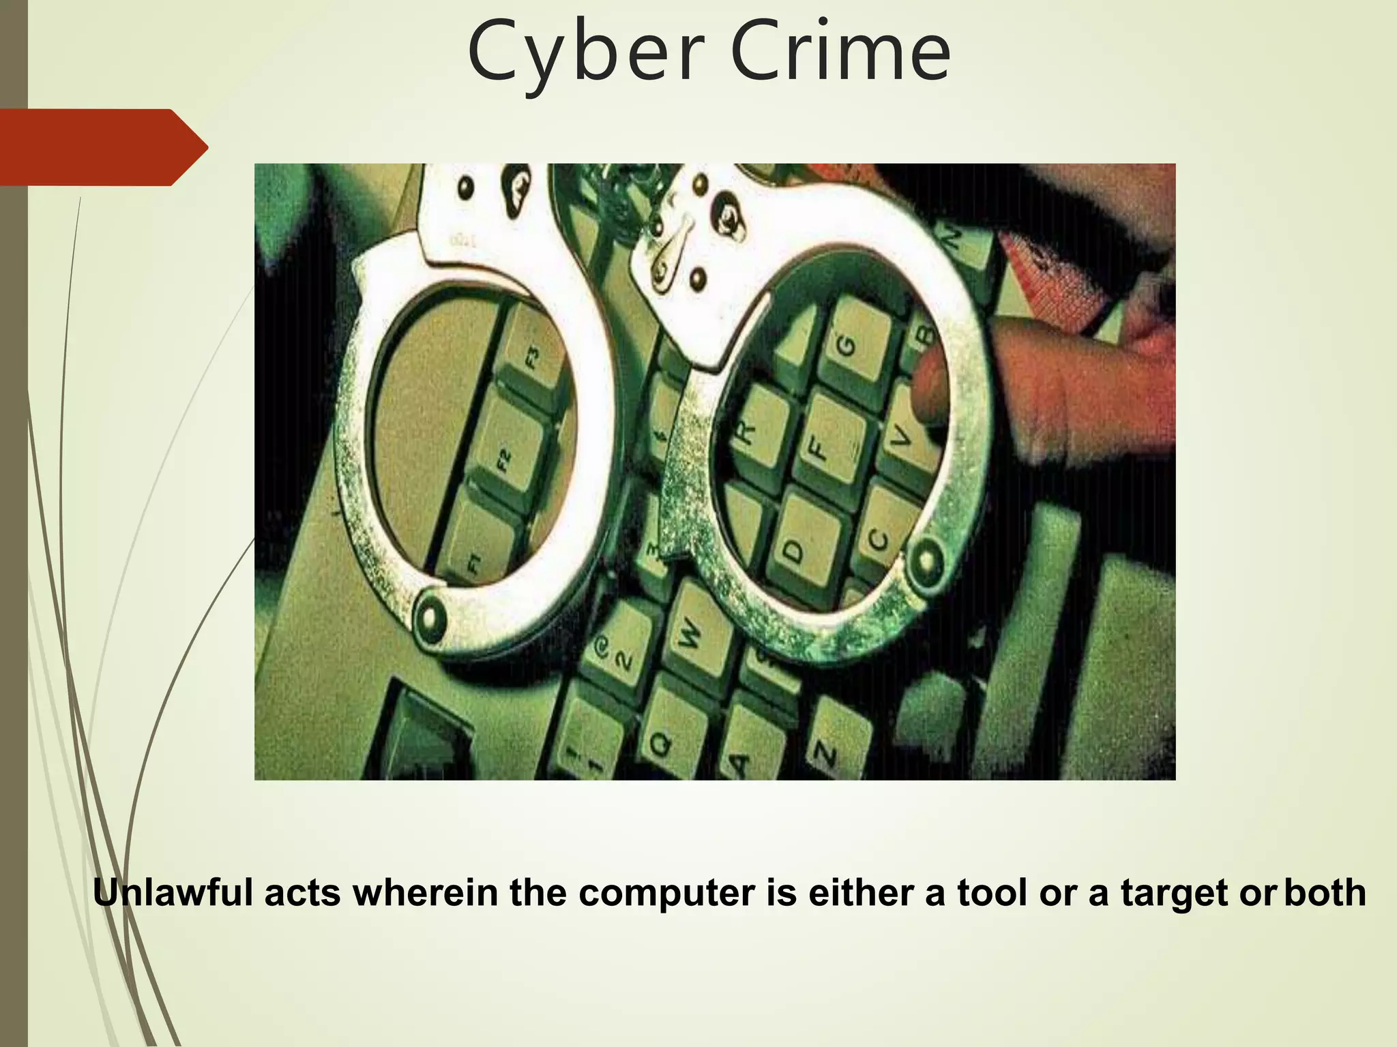
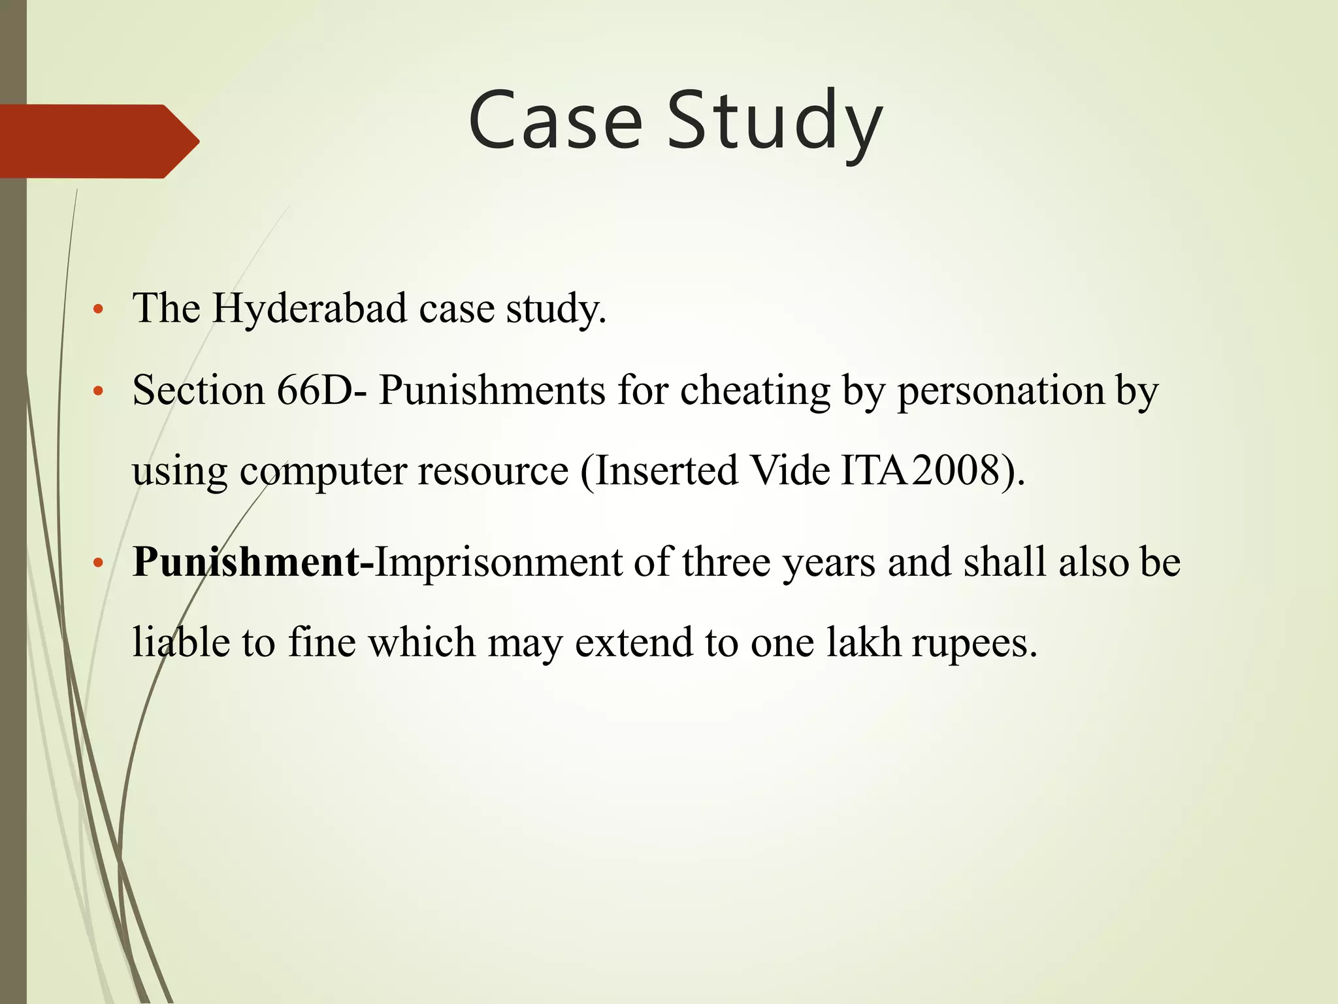

Slide 23
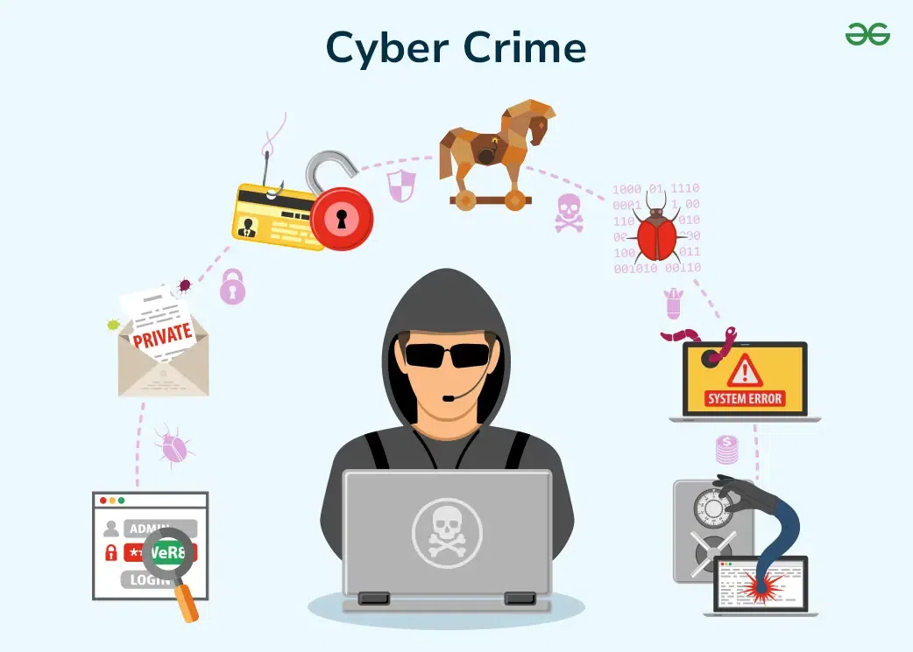

Slide 24
Cyber Law
Cyber law is an integral part of the legal system. It deals with the legal issues of cyberspace.
Cyber law is also referred to as the Law of the Internet. These cyber laws help businesses prevent identity and data theft, privacy violation and fraud.
The Information Technology Act, of 2000, as per the Indian Penal Code, addresses Cyberlaw and includes laws related to e-commerce, e-contracts, digital signatures, intellectual property rights, and cyber security.
Cyber law is referred to as the Law of the Internet of Digital Law and applies to the various categories of cyber-crimes, such as –

Slide 25
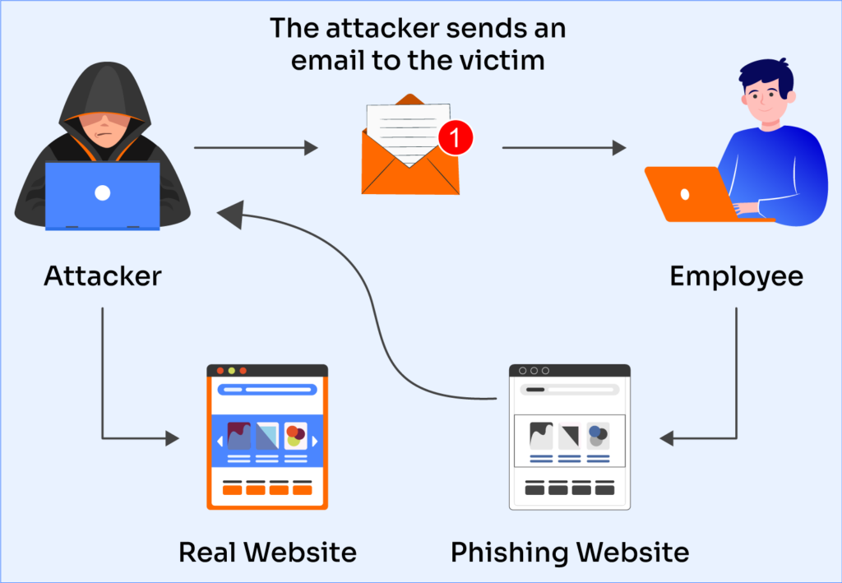
Most common cyber crimes
Phishing: It is the practice of tricking people into divulging personal information by means of phoney emails or websites.

Slide 26
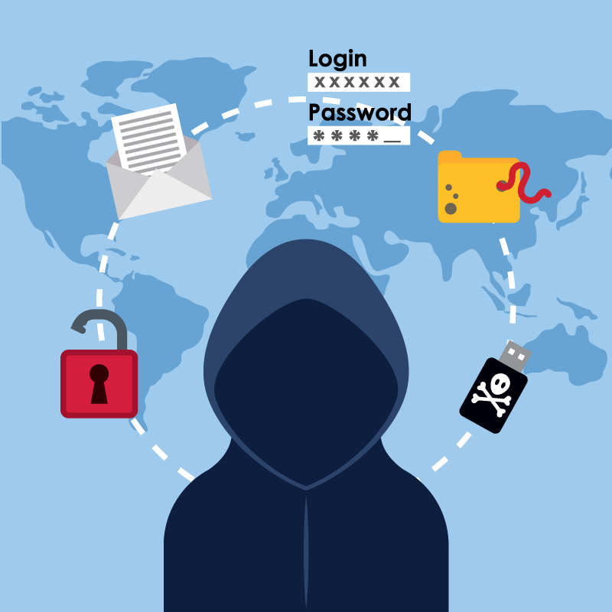
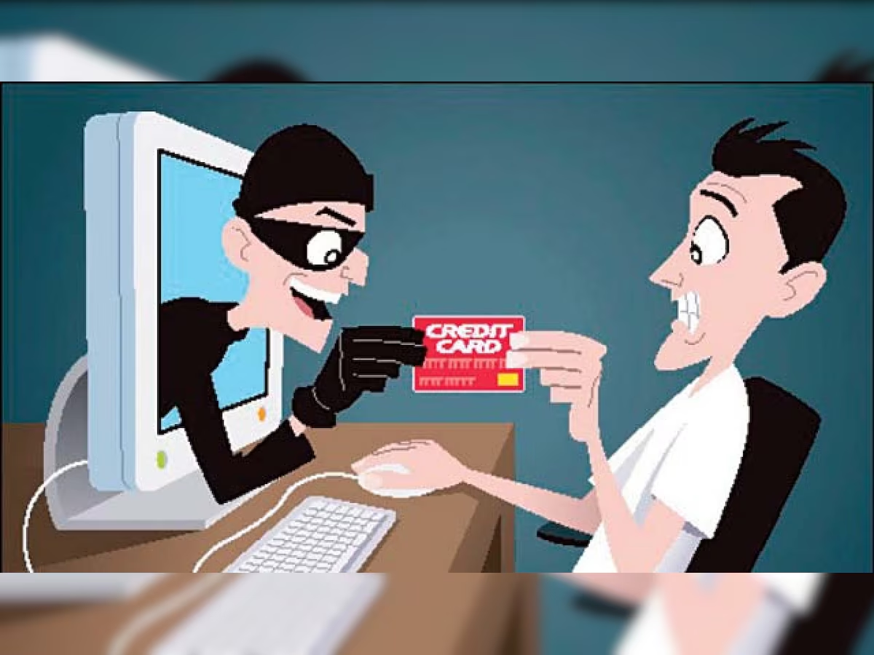
Most common cyber crimes
Identity Theft: In this case, hackers steal personal data from a victim in order to impersonate them and profit financially. Imagine if someone opened a credit card or made purchases online under your name.
Online Fraud: This type of fraud involves deceiving people into parting with their money through the use of fake websites or investment scams.

Slide 27
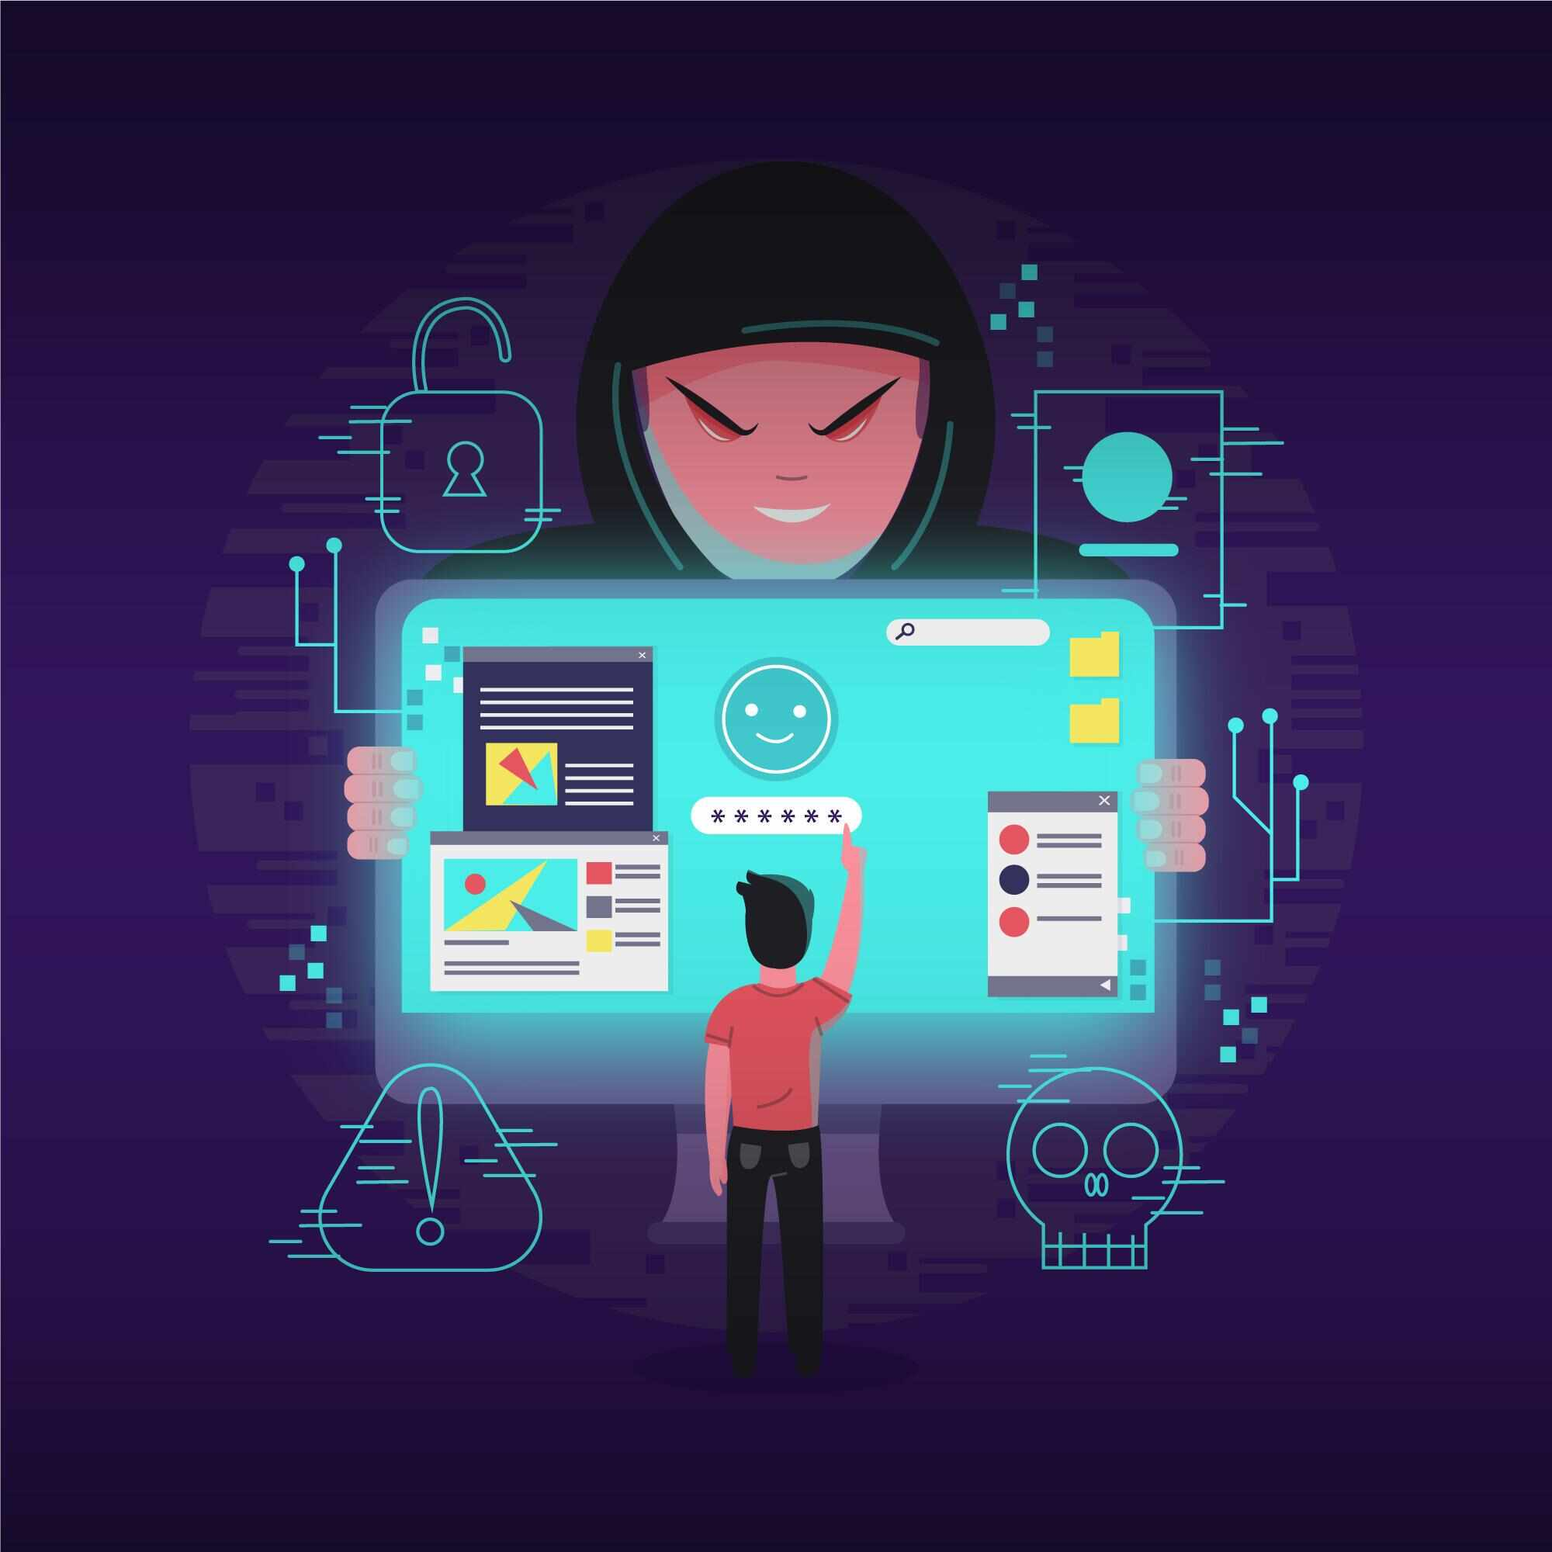
Most common cyber crimes
Malware Attacks: These involve installing harmful software on computers in order to take control of systems, steal data, or use ransomware to encrypt data.
Data breaches: When private or financial information is exposed due to unauthorised access to sensitive data kept on computer systems, there can be serious ramifications.

Slide 28
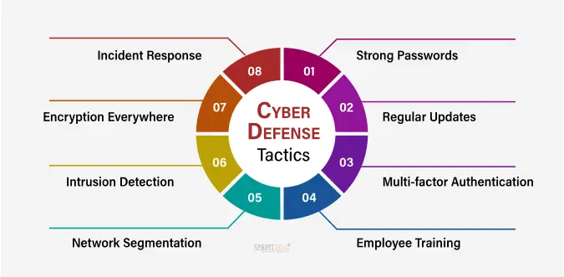
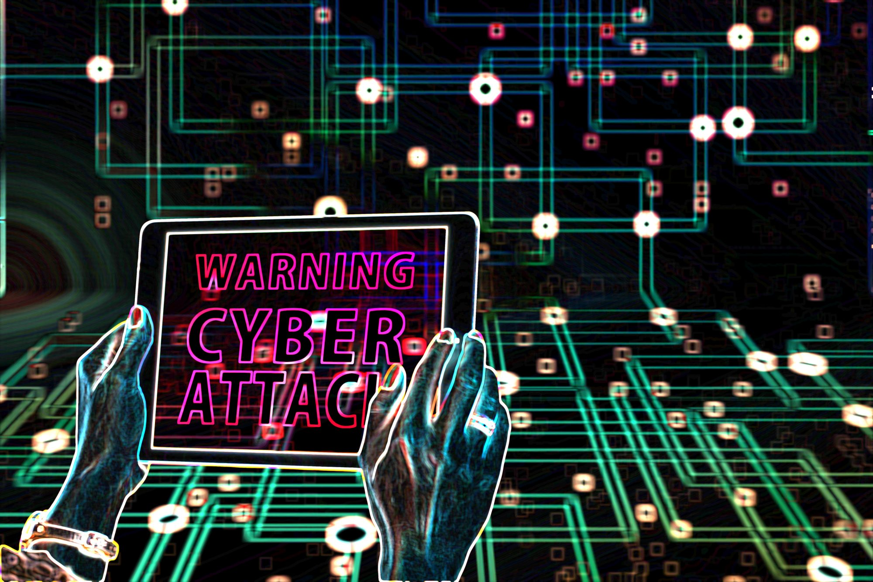
Prevention

Slide 29
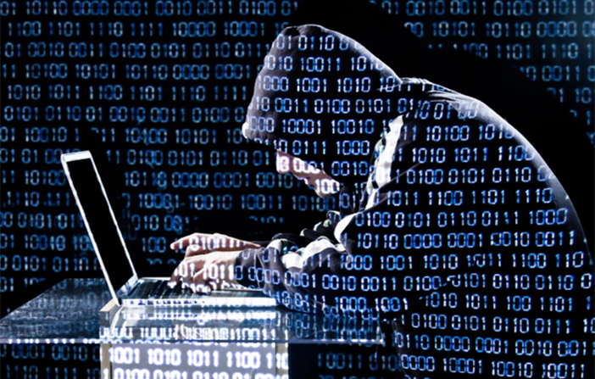

Cyber crime in India

Slide 30
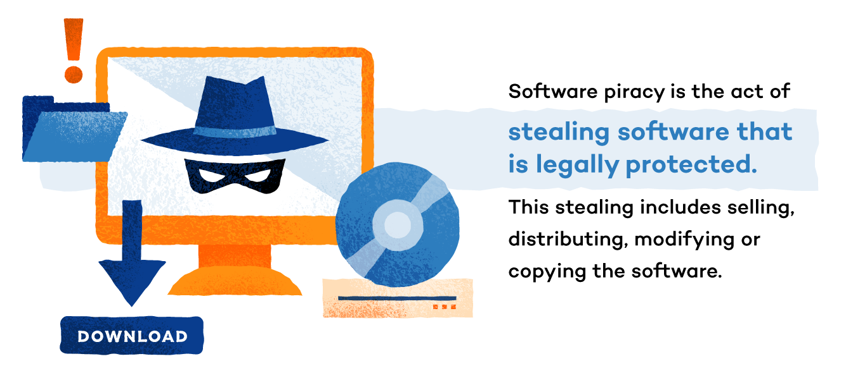
Software piracy

Slide 31
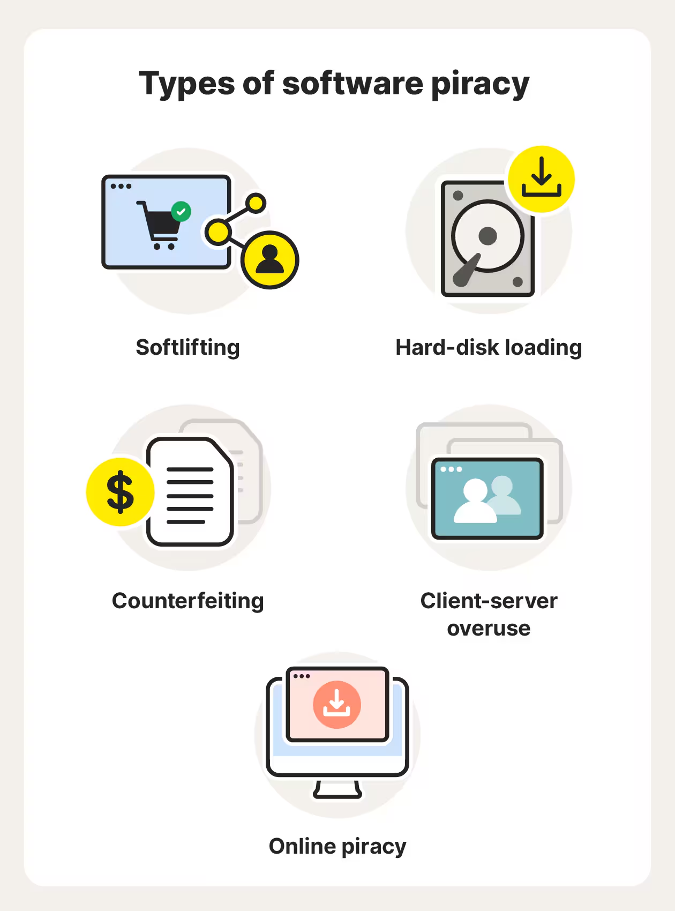

Slide 32
Types of Software Piracy
Softlifting- Softlifting is the most common type of software piracy. In this piracy, the legal owner of the software is one, but the users are multiple.For example, many times we borrow software from our colleagues and install a copy of that on our computers just to save money which rises to softlifting one type of software piracy.
Hard-disk Loading- It is the most common type of software piracy which mainly happens in PC resell shops. The shop owner buys a legal copy of the software and reproduces its copies on multiple computers by installing it.

Slide 33
Types of Software Piracy
Counterfeiting- In counterfeiting the duplicates are created of genuine/legal software programs with the appearance of authenticity. Then these duplicate software are sold out at a lower price.
Client-Server overuse – In client-server overuse, more copies of the software are installed than it has licensed for. Mainly it is seen in local business sectors when they work under a local area n/w and install the software in all the computers for use by many employees which is an unauthorized practice.
Online Piracy- In online piracy, the illegal software is acquired from online auction sites and blogs which is mainly achieved through the P2P(Peer to Peer) file-sharing system. As it is acquired using the Internet, often it is called Internet Piracy.

Slide 34
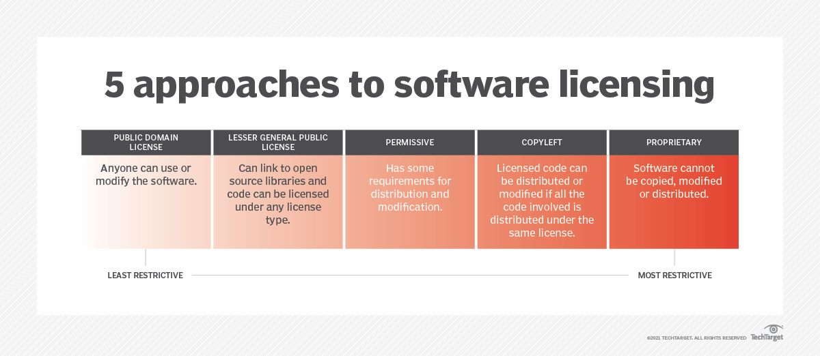
Software license
Software licenses typically provide end users with the right to one or more copies of the software without violating copyrights.

Slide 35
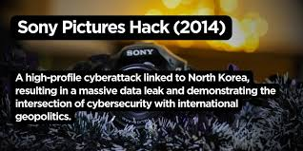
Case study
The Sony Pictures Hack:
Took place in 2014, hackers managed to infiltrate the network of Sony Pictures and release confidential data and other critical information including private communications between executives and employees’ personal details. This led to a massive setback for Sony causing huge financial loss and reputational damage. Sony Pictures incurred heavy investments in improving its cybersecurity measures and making numerous legal settlements.
Cybersecurity case studies for incidents like this highlight the importance of improving a company’s network security and more careful management, handling and protection of data.

Slide 36

Yahoo attack:
Another one of the biggest security attacks and data breaches in history is the Yahoo attack that caused the hacking of about 500 million Yahoo accounts. This was reported as a state-sponsored attack where the hacker invaded Yahoo’s systems and stole data. This included Yahoo account holders’ names, phone numbers, birth dates, email addresses, security questions, etc. Although Yahoo had apprehended the intrusion in 2014 they failed to disclose the breach to the public causing numerous identity theft and phishing attacks.
A case study into such security incidents exposes the need for immediate security response and compliance with security regulations.

Slide 37


